Slide 1
Reducing Carbon Dioxide Emissions

Slide 2
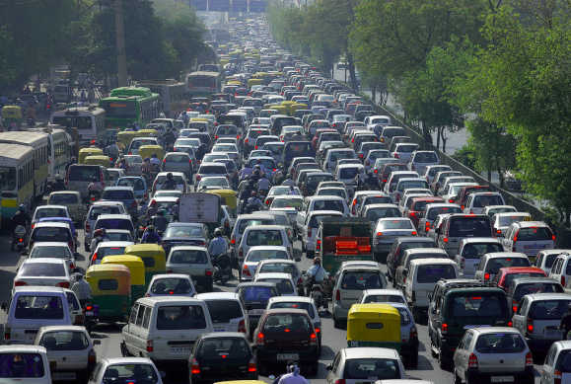
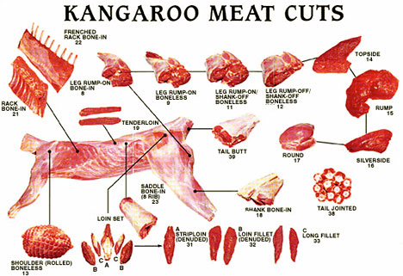
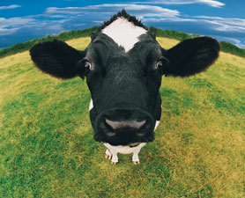
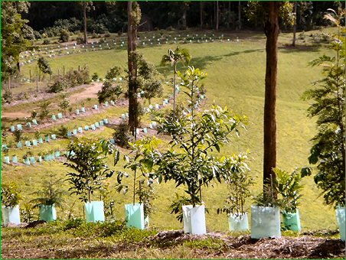
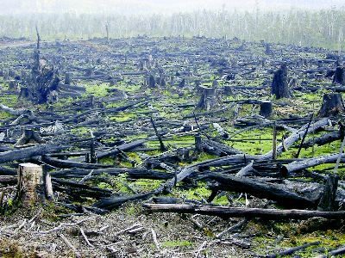
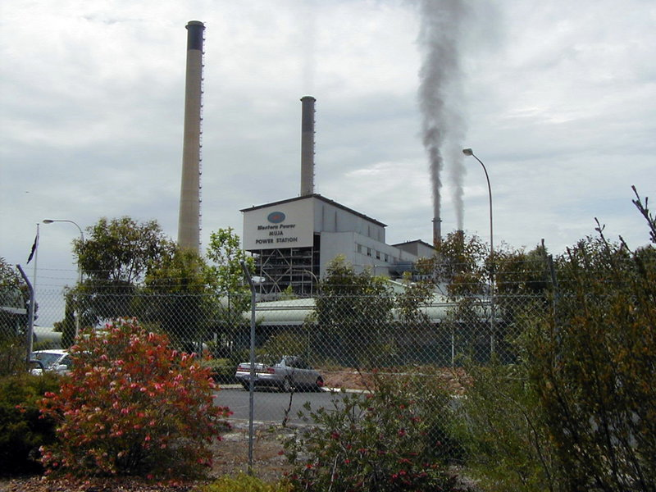
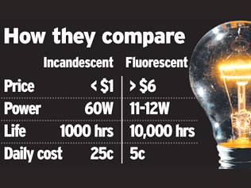
Notes:
Bottom left: Mujua Power station in Collie, W.A. Generates 5.56 million tonnes of Greenhouse Gases per year. It has eight steam turbines served by coal-fired boilers that together generate a total capacity of 854 MW of electricity. The coal is mined in the nearby Collie Sub-basin. According to the National Pollutant Inventory (NPI), Muja Power Station is one of the biggest emitters of air pollution in Australia, including high emissions of beryllium, fluoride and particulate matter.

Slide 3
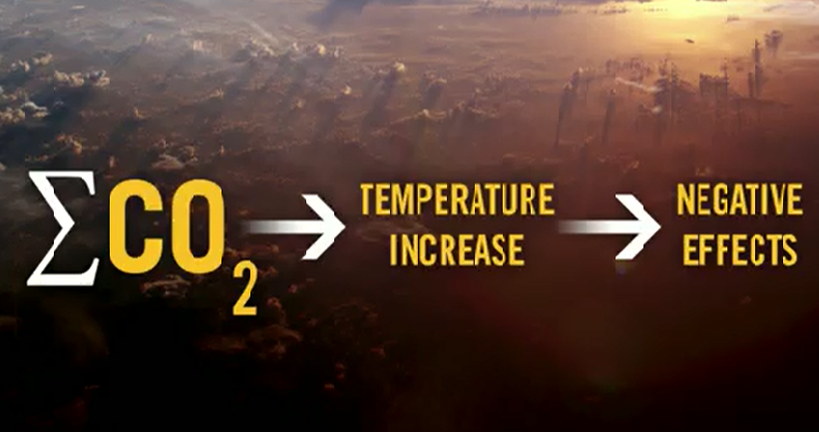
TASK 2:
Watch the Bill Gates TED Video (18.5mins). Fill in the blanks on your handout

Slide 4
Bill Gates was considering that we increase our source of energy in a way that does not release Carbon Dioxide into the atmosphere…..
He did also state that we can reduce our energy use in western countries
TASK 3
Go to the WWF Carbon Calculator website to find out how much Carbon Dioxide you emit with the services and products you use.

Slide 5
TASK 4: Transport
In groups, discuss the mode of transport you use most frequently and the car your family uses.
Is your car in the high performers list?
Would you consider buying a ‘green vehicle’ when you get your license?

Slide 6
TASK 5: Create a poster
In your groups, make a list of 10 things you could do to save energy with your mobile phone!

Slide 7
What else can we do??????

