Slide 1
Ocean Currents

Slide 2
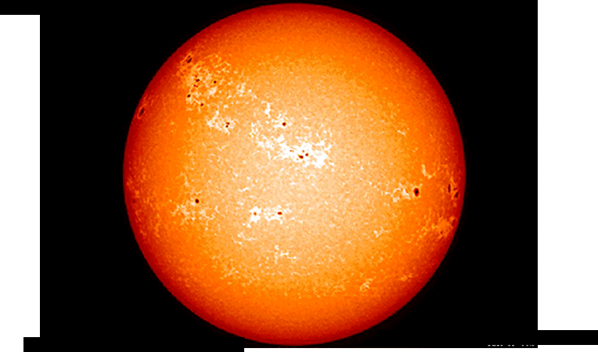
The Earth spins as it orbits the Sun.
TASK 1:
Fill in the blanks on your handout
Sunlight
Earth’s North and South Poles are further from the Sun than the Equator. They receive less sunlight (and less heat) so water freezes there. It is also colder, in deep Ocean water than in shallow Ocean water.

Slide 3
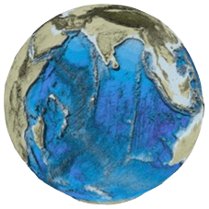
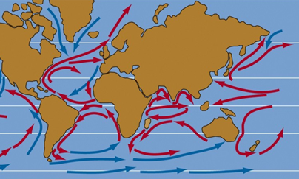
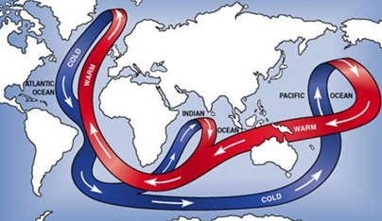
The Ocean is water that pools in the lower parts of Earth’s Crust. Continents (dry land) are higher parts of the Crust that stick out of the Ocean.
Earth’s spinning makes water at the Equator deflect (turn). This is known as the coriolis effect..
Differences in water temperature also cause currents. Colder, denser water sinks and warmer, lighter water rises. This is a convection current.
TASK 2:
Answer the 3 questions on your handout

Slide 4
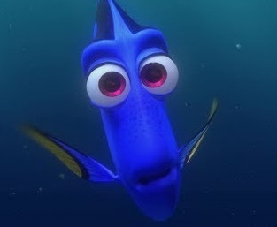
TASK 3: VIDEO…. Pay attention please

Slide 5
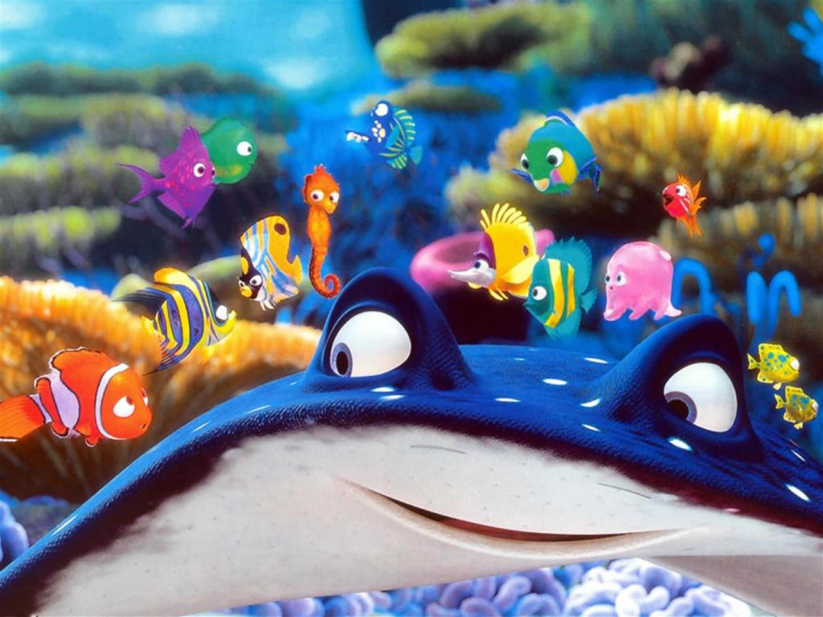
TASK 4: Make your own Coriolis Effect simulation

Slide 6
TASK 5: Draw and label the 5 Ocean Gyres from the next Powerpoint slide

Slide 7
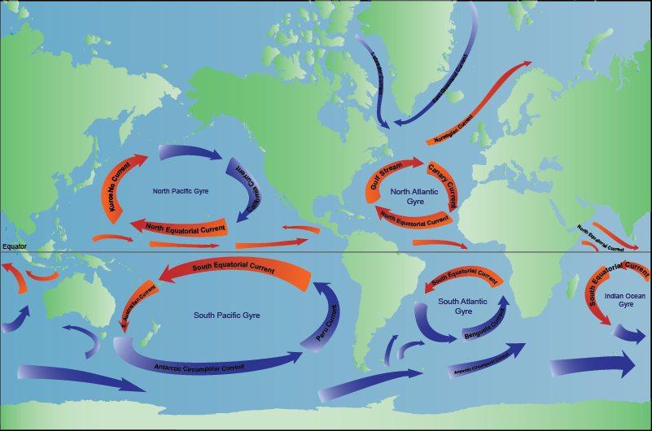
Ocean Gyres – Deflected water Moving in a circle!

Slide 8
TASK 6: Demonstration Pay attention please

