Slide 1
Half Life
Just a matter of time…

Slide 2
Revision
Hydrogen has the symbol ___ Deuterium is a stable isotope of hydrogen with one neutron per atom. Tritium is a radioisotope of hydrogen containing two neutrons per atom.
A) Determine the symbols for deuterium and tritium.
B) Two deuterium nuclei can bond to form a helium nucleus. Construct a nuclear equation for this reaction.

Slide 3
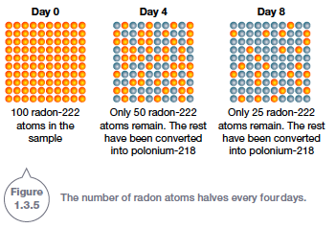
Half Life
The rate at which nuclear decay takes place is measured by a radioisotope’s half-life. The half-life of a radioisotope is the time it takes for half the nuclei to decay.

Slide 4
Half life
The time required for something to fall to half its initial value (in particular, the time for half the atoms in a radioactive substance to disintegrate)

Slide 5
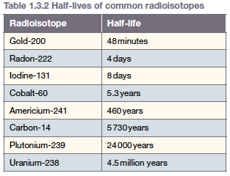
Some other half-lives

Slide 6
Carbon Dating
The half-life of carbon-14 is used to determine the age of fossils and ancient materials through a process known as carbon dating.
Carbon dating relies on the fact that all living things contain a small amount of carbon-14.
The amount remains constant throughout the lifetime of the plant or animal. This is because carbon-14 is constantly being absorbed by the organism through its food and air.
However, when the organism dies, carbon-14 is no longer absorbed. At that point, the small amounts of carbon-14 in the organism begin to decay.

Slide 7
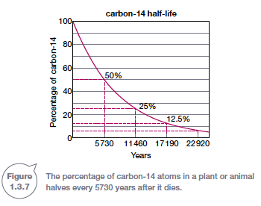
Carbon - 14

Slide 8
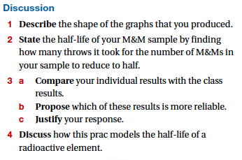
Half Life - Practical
We can conduct a simulation of half life using probability or chance.

