Slide 1
Effects of Radiation
Mutants!

Slide 2
Revision
The half-life of carbon-14 is 5730 years. Calculate how much of the original carbon-14 would be left in a fossil that is 17 190 years old.
If a fossil only contained 1/16th the amount of carbon as a living organism, how old would it be?

Slide 3
Biological effects of Radiation
Alpha particles, beta particles and gamma rays are particularly damaging to the cells of living organisms.
Alpha particles, beta particles and gamma rays are referred to as ionising radiation because they can remove electrons from atoms and molecules. Exposing cells to ionising radiation can cause cells to die or mutate.

Slide 4
Cell Death
Cell death occurs when radiation enters the cell and destroys the biological molecules beyond repair. This may result in radiation burns or radiation sickness.

Slide 5
Radiation sickness may result from exposure to a large amount of radiation in a short amount of time, or a lower amount of radiation over a longer period of time. The symptoms include nausea, vomiting, fever, hair loss and diarrhoea.

Slide 6
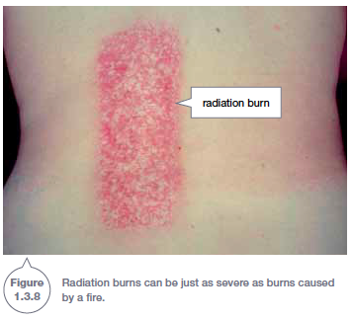
Radiation Burn

Slide 7
Cell Mutation
Cell mutation occurs when the radiation damages the DNA inside the cell without causing the cell to die.
If the DNA is damaged, the cell is reprogrammed and may cause the cell to develop into a cancer.
The likelihood of cell mutation increases as the exposure to ionising radiation increases.

Slide 8
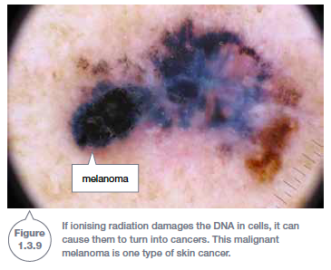
Skin Cancer

Slide 9
Dose
Whether or not an exposure to radiation is harmful depends on the type of radiation and the amount of radiation. The amount of radiation absorbed is known as the dose, measured in sieverts.
Every year you receive approximately 1400 μSv of radiation from isotopes in the ground (terrestrial radiation) and 300 μSv from outer space (cosmic radiation).

Slide 10
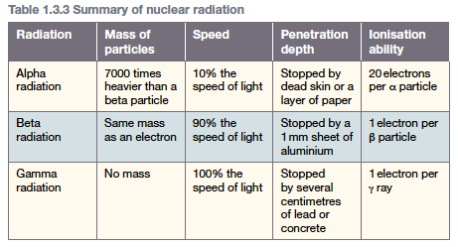
Radiation Type

Slide 11
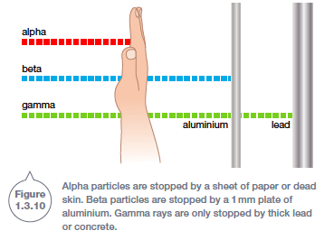

Slide 12
