Slide 1
Elements and Compounds
Mix and Match

Slide 2
Revision
Write the electron configuration for Chlorine (Cl) and Magnesium (Mg) and then for their ions.
Draw a diagram of the structure of an atom.
Fill in the table:
Particle | Charge | Mass | Location
Proton
 | 0 |  | Nucleus
 |  | 0

Slide 3
Element
An Element is a substance made from ONE type of atom.
This can be either a single atom on its own or two or more atoms of the same type joined together.
MOST elements do not exist as a single atom on its own.

Slide 4
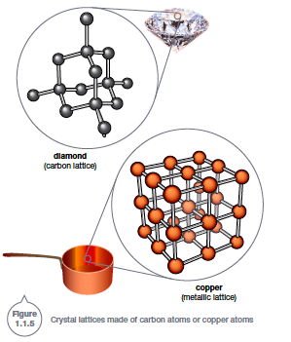
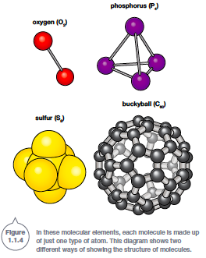
Ar
Kr
He
Ne

Slide 5
Compounds
A compound is two or more DIFFERENT atoms joined together.

Slide 6
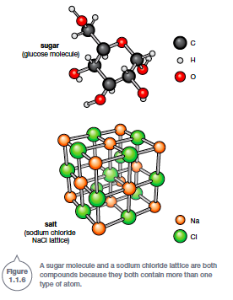
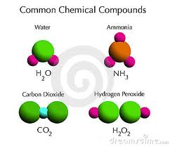

Slide 7
Metal
…not the music.

Slide 8
Metals: Properties
Ductile
Malleable
Dense
Electrical Conductor
Heat Conductor
Shiny
Solids at room temperature (Except for?????

Slide 9
Alloys
Most metals cannot be used as pure elements because they have properties that make them impractical. For example, most pure metals are too soft to be made into anything useful.
An alloy is a metal (known as the base metal) combined with small amounts of another element. The properties of the new alloy are usually an improvement over those of the base metal.

Slide 10
Alloys: Steel
For example, steel is much stronger and harder than its iron base metal, allowing it to be used in everything from paperclips, staples, nails and screws to cars, ship hulls and the frames of bridges and skyscrapers.
Steel is an alloy of iron with small amounts of carbon added to it.

Slide 11
Alloys: Steel
Different amounts of carbon produce different alloys:
Wrought iron contains almost no carbon and is the closest alloy to pure iron.
Mild steel has only 0.5% carbon.
Hard steel or tool steel has about 1% carbon.
Cast iron has between 2.4% and 4.5% carbon. Cast iron is strong but brittle, shattering easily if hit or dropped.

Slide 12
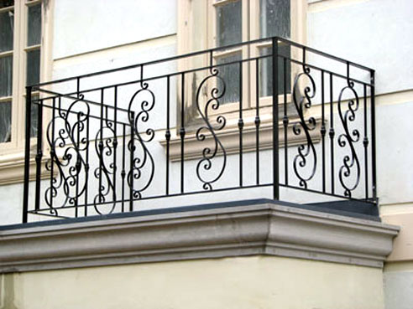
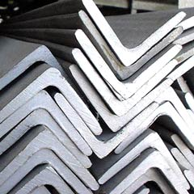
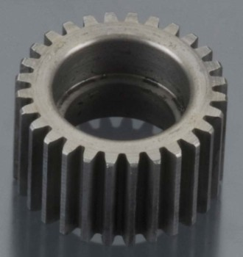
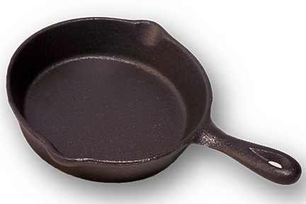
Wrought Iron
Mild Steel
Hard Steel
Cast Iron

Slide 13
Making Models
Using different coloured clay to represent different types of atoms try to make the elements and then compounds on the next slide.
RED – Oxygen
BLUE – Hydrogen
YELLOW – Carbon

Slide 14
Making Models
Make 5 Hydrogen Atoms (H)
Make 5 Oxygen Atoms (O)
Make 4 Carbon Atoms (C)
Make 1 Hydrogen molecule (H₂)
Make 1 Oxygen molecule (O₂)
Make 1 Carbon Dioxide molecule (CO₂)
Make 1 Methane molecule (CH₄)
Make 1 Water molecule (H₂O)
Make 1 Ozone molecule (O₃)

Slide 15
Questions
Why is Iron such a commonly used metal?
What element is added to Iron to make it stronger?
Blacksmiths repeatedly heat, hammer and cool (quench) steel in the process of making horseshoes. Propose a reason why.

Slide 16
Questions
Classify each of the molecules the you made as either elements or compounds.
COMPOUND | ELEMENT

