Slide 1
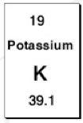
Revision- Think-Pair-Share
Which is the atomic number?
What does the atomic number tell us?
What is the mass number?
What does the mass number tell us?
How many protons does Potassium have?
How many neutrons?
How many electrons?

Slide 2
Revision
What is the charge of an electron?
How many electrons does a Argon atom have?
How many neutrons does Fluorine have?
Name the folowing: B, O, K, Si, Na

Slide 3
Octet Rule
Hydrogen and Helium are filling the first shell and only require 2 electrons to be stable.
The next shell requires 8 electrons, then 18, then 32
After Hydrogen and Helium, the rest of the first 20 Atoms require 8 electrons in their outermost shell.
Remember: 2,8,18,32

Slide 4
Try writing the electron configurations for these:
Carbon
Oxygen
Fluorine
Chlorine
Bromine
Beryllium
Magnesium

Slide 5
Try writing the electron configurations for these:
Carbon
Oxygen
Fluorine
Chlorine
Bromine
Beryllium
Magnesium

Slide 6
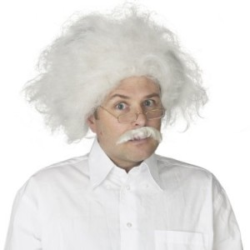
Cations and Anions
Opposites Attract

Slide 7
Octet Rule
Electrons orbit the nucleus of all atoms, certain configurations of electrons are more stable than others.
All atoms are trying to establish a stable configuration.
A stable configuration is an outer shell with 8 (except H and He, Li and Be which want 2).

Slide 8
They do this by either loosing or gaining electrons from their outer most shell.
Only the outermost electrons can be traded.
This is a form of chemical bonding called Ionic Bonding

Slide 9
Ions
Ions are the charged forms of elements.
They occur by gaining or loosing outermost electrons.

Slide 10
Some elements tend to gain electrons whilst others tend to loose electrons. They will do whatever is easiest.
For example: It is easier for Sodium to loose 1 electron and become stable than gain 7 electrons to become stable.

Slide 11
Cations
This is the name for positively charged ions.
Cations are formed by loosing electrons, since electrons have a negative charge.
Metals form Cations
Charge is written as a number and sign above the symbol.
Eg. Na⁺, Ca²⁺, Mg²⁺, K⁺, Cu²⁺, Al³⁺

Slide 12
Anions
This is the name for negatively charged ions.
Anions are formed by gaining electrons, since electrons have a negative charge.
Non-Metals form anions
Charge is written as a number and sign above the symbol.
Eg. Cl⁻, O²⁻, N³⁻, S²⁻, F⁻, P³⁻

Slide 13
Electrical Conductivity
Electrical current is due to a movement in charge.
Electricity through a wire is due to movement of electrons.

Slide 14
Electricity through a liquid solution is due to the presence of charged ions.
If there are no ions then there will not be any conduction.

Slide 15
Questions
How many electrons do the following atoms have:
Write their electron configurations
Write the electron configurations of their ions
Write their symbol and show the charge of the ion.
H | He | Li | Be | B
C | N | O | F | Ne

