Slide 1
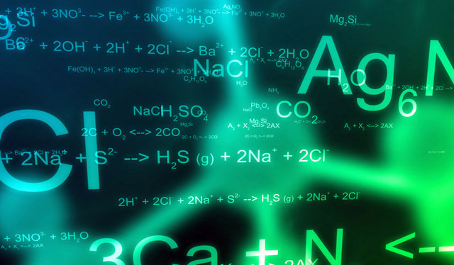
Equations

Slide 2
Today
By the end of the lesson you will:
Describe chemical change in terms of atoms and molecules rearranging
Be able to define the term reactant and product
Be able to write simple word equations

Slide 3
Chemical Science
In a chemical change we know that a new substance is created.
But how does this occur? How do we start with one item and end with another?
Today we will answer this question.

Slide 4
Chemical Science
We know that substances are made of atoms and molecules.
When an chemical change occurs, the atoms in the molecules re-arrange to form different combinations.
The substances we start with are called reactants
The substance we end up with are called products
Reactants Products

Slide 5
TASK: DRAW PICTURE
The following is an example of a chemical reaction
You can see that the atoms in the reactants are the same as the atoms in the products, but they have been re-arranged.

Slide 6
TASK: DRAW PICTURE
During a chemical reaction atoms are never created or destroyed they are just re-arranged.
If you start with 4 hydrogen atoms and 2 oxygen atoms, you will always end with 4 hydrogen atoms and 2 oxygen atoms.

Slide 7
Chemical Science
We often use equations to represent chemical reactions.
A word equation is exactly as it sounds an equation with words!
But even more useful is a formula equation which uses the chemical names of the reactants and products.

Slide 8
Chemical Science
An example:
When natural gas, methane (CH₃) is burnt in oxygen gas (O₂), it produces carbon dioxide (CO₂) and water (H₂O). Write a word equation and formula equation for the reaction.
Methane + oxygen carbon dioxide + water
CH₃ + O₂ CO₂ + H₂O

Slide 9
Chemical Science
Your turn.
When a sodium chloride (NaCl) solution is mixed with silver nitrate (AgNO₃) solution, white silver chloride (AgCl) is produced and a sodium nitrate (NaNO₃) solution. Write the word equations.

Slide 10
ACTIVITY
WORKSHEET
Identify how many atoms of each element are present in each of the following formula.

