Slide 1
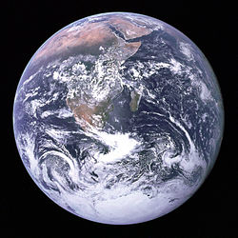
Earth Science- The Biosphere

Slide 2
What is Recycling?
Why is it important?
Notes:
Reusing materials that would otherwise run out. Recycling makes life more sustainable.
Because of the limited resources. Animals naturally fit in with the environment but humans tend to use up the resources. As well as the large amount of area that landfill takes up.
The idea of recyling comes from Nature, which does it naturally.

Slide 3
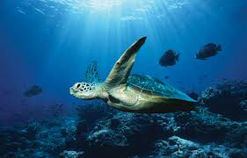
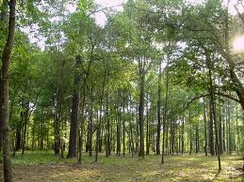
Hydrosphere, also known as
Atmosphere, also known as
Name these
ecosystems
AIR
Lithosphere, also known as
WATER
LAND

Slide 4
A BIOSPHERE is the total of all ecosysterms

Slide 5
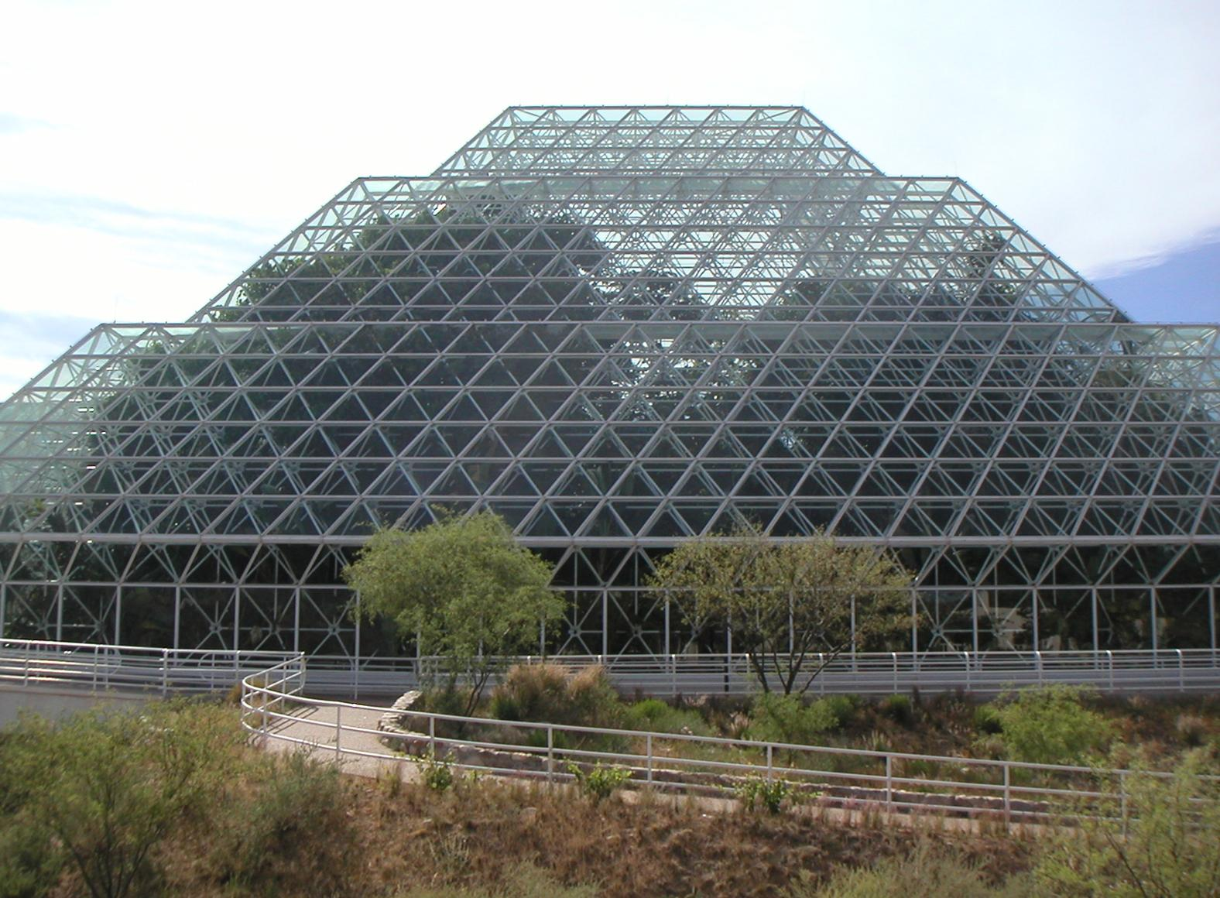
Please watch the video and and answer the questions on the worksheet

Slide 6
The movie goes here

Slide 7
Now, on the back of your sheet, fill in the ways that humans affect the Earth’s AIR, EARTH and OCEANS

