Slide 1
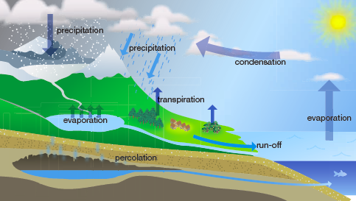
The Water Cycle

Slide 2

Task 1: Think-Pair-Share
Think about other ‘cycles’ you have learned about so far. What does ‘cycle’ mean? What do you think the water cycle might be about?
You have 1 minute to discuss these 2 questions with the person next to you. Your teacher will choose some people to share their ideas with the class.

Slide 3
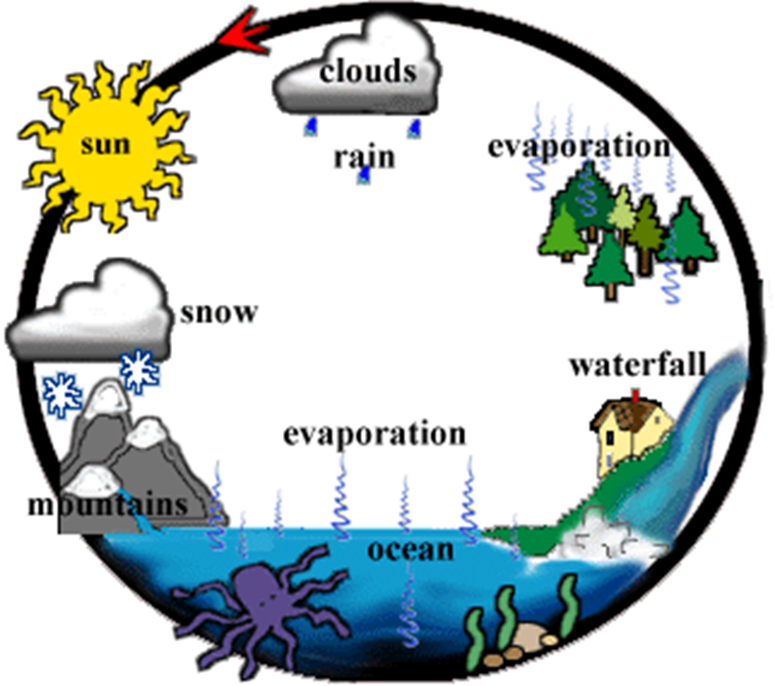
Cycles – something going round and round
Water can exist as a solid, liquid or gas and in nature each molecule of water moves through the water cycle

Slide 4
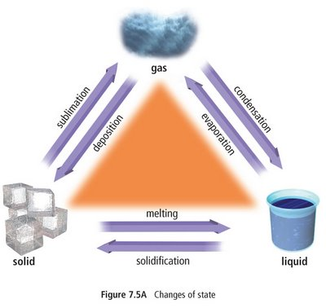


Water Cycle Processes….
Changing ‘state’
Heat from the sun, gives liquid water molecules (in oceans, lakes and so on) enough energy to EVAPORATE, that is, spread out into a GAS state.
As this GAS (water vapour) rises and gets further from the Earth’s surface, the water molecules lose heat energy and begin to CONDENSE, that is, get closer together and form bonds between molecules. This is how clouds are formed, which leads to rain or even snow.

Slide 5
Task 2: Pearson Textbook p180
Go to page CHAPTER 6 10.12 page 180 of your science textbook and read the information under the Water Cycle heading, including the information in the text box next to figure 6.1.7
Using this information, fill in the answers to question 1-7 of the Water Processes Crossword

Slide 6
Task 3: Water Corporation Example
Go to the Water Corporation Website link:
http://www.watercorpeducation.com.au/page/19/The-Water-Cycle
Note that the water molecules are going on a journey through 12 stages, in this given example, which is more detailed than the Global example given in your textbook. THIS example includes local use and how water is redirected by human beings.
You can use the arrows or the dots (bottom right) to navigate.

Slide 7
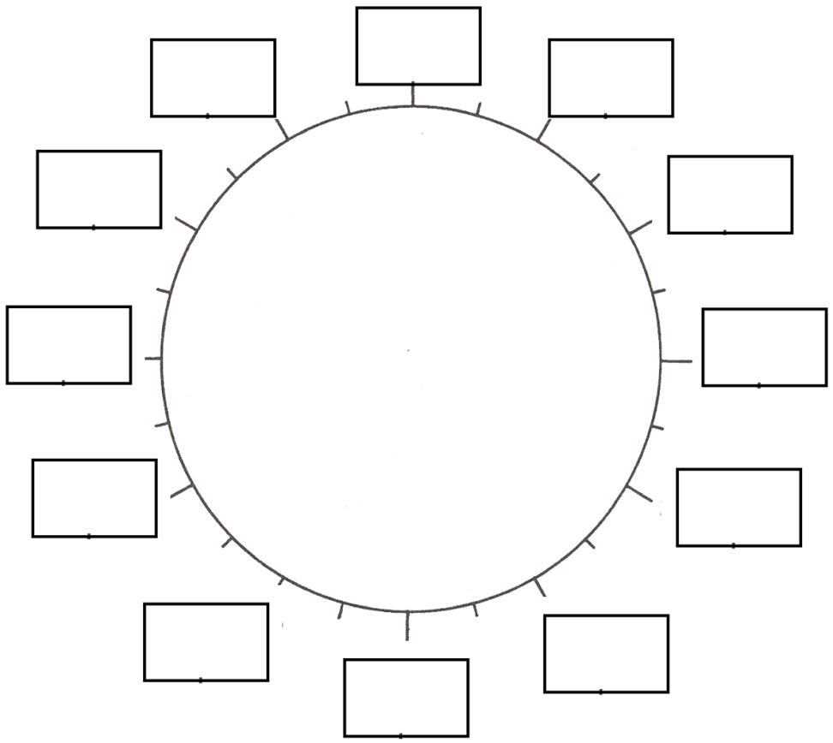
Task 3 Continued….
On this diagram (other side of your worksheet), write down the name for each stage given on the Water Corporation’s water cycle example. Write inside the rectangles.
Also include: 1. whether the water is in liquid, gas or solid form. 2. Where the water is (in the sky, the ocean, a river, a water treatment plant, underground? 3. Between which stages in the cycle does condensation happen? Show this on your diagram above.

Slide 8

Human Impacts
In the early settlement period of Western Australia, it was law that anyone owning land had to clear 40% of that land of trees. These trees had been drinking groundwater and had stopped the water rising up through the soil. When those trees were gone, the water level rose and collected salt as it flowed through the soil above it. This has impacted farmers now, as their land is not able to support crops

Slide 9
Task 4: Class discussion (groups)
Can you think of other ways humans have changed the flow of water, by taking water that may have normally been left alone….

