Slide 1
Influences on Climate
All from the Sun…

Slide 2
Revision
Draw a labeled diagram of the water cycle without looking back at your notes.
What is the biosphere?
Explain how decomposers return carbon to the atmosphere.

Slide 3
Influences on Climate
The Sun is the ultimate source of energy for most living things, and it keeps the planet warm enough to support life.
Energy from the Sun is a major influence on climate. However, other factors also influence the world’s climate.

Slide 4
Surface of the Earth
Characteristics of the Earth’s _________ determine how much of the energy from the Sun is __________ back into space
Clouds and the ice of the Arctic and _________ reflect most of the energy coming in from the Sun.
Ice reflects about ____ compared with the dark green forests, which reflect ____.
Missing Words: Antarctic, Surface, 84%, Reflected, 14%

Slide 5
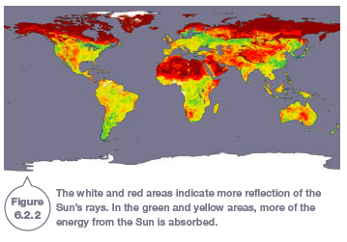
Surface of the Earth

Slide 6
Gases in the Atmosphere
Nitrogen and oxygen are the gases that make up most of Earth’s atmosphere, and they have no effect on the radiation coming in from the Sun or on the radiation going back out into space.

Slide 7
Water vapour, carbon dioxide, methane, nitrous oxide and ozone all allow the incoming short-wave solar radiation to pass through. However, they absorb the out-going long-wave radiation (heat).
These gases have the effect of trapping heat close to the Earth’s surface, keeping it warmer

Slide 8
Greenhouse Gases
Water vapour, ______________, methane, nitrous oxide and ozone are called greenhouse gases and cause the greenhouse effect.
The ___________ effect is the warming of the Earth due to heat being emitted from these gases back to the __________.
Theses gasses act like the glass walls of a greenhouse.
Missing words: greenhouse, carbon dioxide, surface

Slide 9
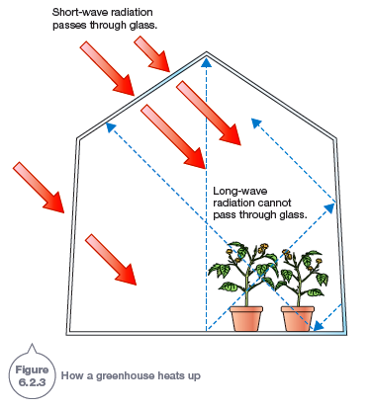
Greenhouse Effect

Slide 10
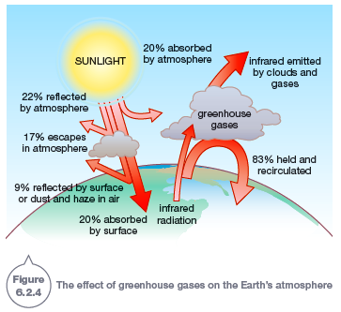
Greenhouse Effect

Slide 11
Orientation of the Earth
The Earth is roughly spherical. It orbits the Sun and rotates on its own tilted axis.
If the tilt of the Earth was different, the characteristics of the seasons would also be different.
As the Earth rotates, the atmosphere and the waters of the oceans are dragged around with it
This movement influences the circulation of the air and water on a global scale.

Slide 12
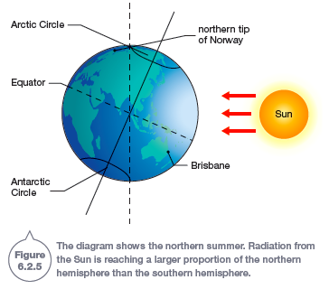

Slide 13
Ocean Currents
Ocean currents are continuous ____________ of ocean water. They can flow for great distances and cause water to ___________ continuously around the whole of the Earth.
This circulation plays an important part in determining the _________ of many of the Earth’s regions.
Missing Words: movements, climate, circulate

Slide 14
Ocean Currents
Currents can be at the surface or deep in the ocean. The main causes of currents are:
wind
temperature
variations in salinity (salt levels)
the rotation of the Earth on its own axis
the gravitational pull of the Sun and Moon.

Slide 15
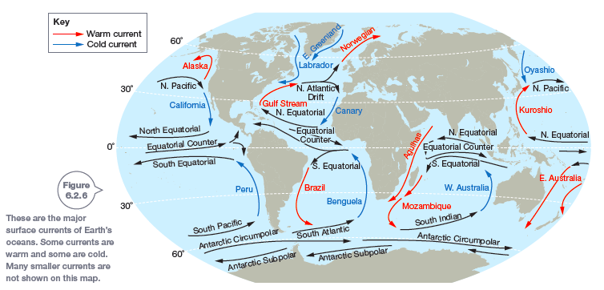
Major Ocean Currents

Slide 16
Surface Currents
The major surface currents of Earth are caused by wind.
In the major ocean basins, the currents form the circular patterns. These circular patterns, called gyres, flow in a clockwise direction in the northern hemisphere and anticlockwise in the southern hemisphere.
The circular pattern of gyres is caused by the rotation of the Earth.

Slide 17
Deep Currents
Deep currents begin at the poles, where extremely cold water is found. They flow through the ocean, carrying very cold water along the bottom.

Slide 18
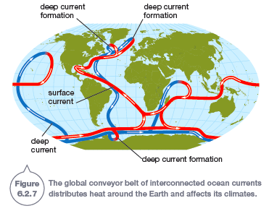

Slide 19
Surface currents and deeper currents interact. Water cycles from deep currents to surface currents, and then back to the deep again, forming the thermohaline circulation (thermo means temperature, haline means salt).
The thermohaline circulation is very slow, taking around 1600 years to complete just one circuit! Scientists commonly call the thermohaline circulation the global conveyor belt.

Slide 20
The global conveyor belt is important because it distributes heat around the globe. By distributing heat, the global conveyor belt affects the climates of the Earth.

