Slide 1
Weather vs Climate
FIGHT!!

Slide 2
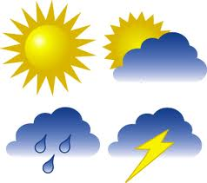
Today
What is the difference between weather and climate
How to we measure weather
What are the major climates on Earth

Slide 3
Weather
TASK 1 – Write the following answers down.
1. Describe the weather in Perth.
2. Describe the climate in Perth.

Slide 4
Weather
Today’s weather is:
<insert weather forecast here>

Slide 5
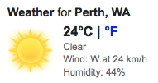
Weather
Weather describes the current state of the atmosphere.
We use certain measurements to explain this including:
Temperature
Wind
Cloud Cover
Precipitation (rain/hail/snow)

Slide 6
Weather
Weather is due to complex interactions between the
Hydrosphere (all the water on Earth)
Lithosphere (all the land on Earth)
Atmosphere (all the gasses surrounding the Earth)
Biosphere (living things on the planet)

Slide 7
Weather

Slide 8
Weather

Slide 9
Weather

Slide 10
Weather

Slide 11
Weather

Slide 12
Climate
Weather is what it happening currently.
Climate is looking at the big picture.
Climate is the long-term averages of weather conditions.
Usually looking at average statistics over 30 years of weather records and including extreme events
Weather can change day to day, climates can also change…but take a longer time.

Slide 13
Climate

Slide 14
Climate
The world can be divided into different climate zones.

Slide 15
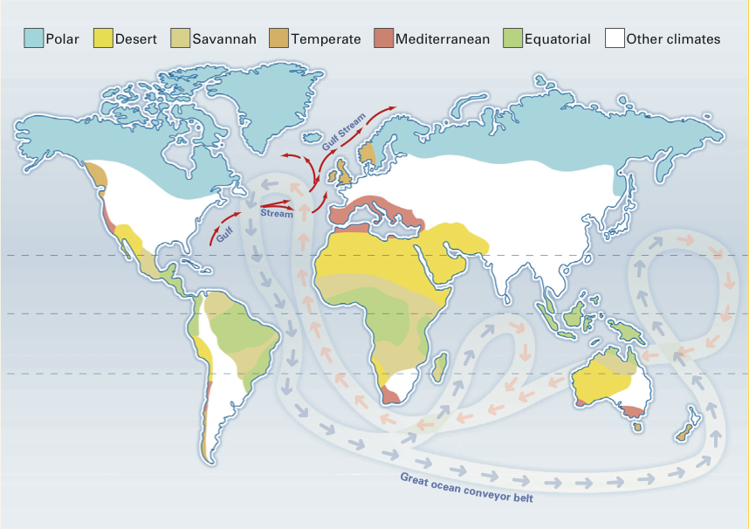
Climate
The world can be divided into different climate zones.

